Slide 1
Lecture 15: Routing – I
Tsung-Wei (TW) Huang
Department of Electrical and Computer Engineering
University of Utah, Salt Lake City, UT

Slide 2
Physical Design Flow

Slide 3
Routing Problem
Scale
Big chips have an enormous number (millions) of wires
Not every wire gets to take an “easy” path to connect its pins
Must connect them all--can’t afford to tweak many wires manually
Geometric complexity
It used to be representing the layout was a simple “grid”
No longer true: at nanoscale, geometry rules are complex – makes routing hard
Electrical complexity
It’s not enough to make sure you connect all the wires
Must ensure delays thru the wires are not too big
And wire-to-wire interactions (crosstalk) don’t mess up

Slide 4
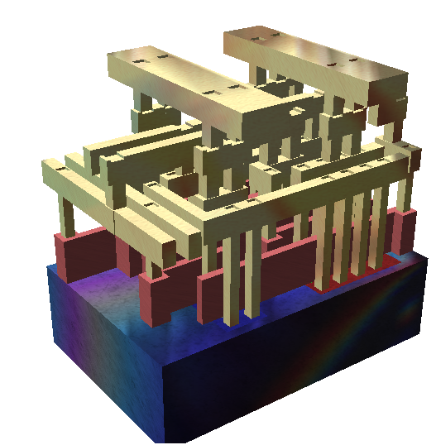
Physical Assumptions
Many layers of wires
Made of metal (today, copper)
We can connect wires in different layers with vias
A simplified view
Standard cells are using metal on layers 1,2
Routing wires on layers 3-8
Upper layers (9, 10) reserved for power and clock distribution (e.g., clock tree network)
Wikipedia: search “standard cell”
http://en.wikipedia.org/wiki/File:Silicon_chip_3d.png

Slide 5
Placement vs Routing
There are lots of different placement algorithms
Iterative methods. Used mainly for high-level floorplanning, not gate layout
Many analytical methods based on solving/optimizing large systems of equations
There are not quite so many routing algorithms
There are lots of routing data structures – to represent the geometry efficiently
But there is one very, very big idea at core of most real routers

Slide 6

Big Idea: Maze Routing
From one famous early paper:
E.F. Moore. “The shortest path through a maze,” International Symposium on the Theory of Switching Proceedings, pp 285--292, Cambridge, MA, Apr. 1959. Harvard University Press
Yes – it’s that Moore of “Moore state machines” fame
Given a maze (or a graph), find a shortest path from entrance to exit

Slide 7
How Do We Get from “Mazes” to “Wires”?
Make a big geometric assumption: Gridded routing
The layout surface is a grid of regular squares
A legal wire path = a set of connected unobstructed grid cells
For us: wires are also strictly horizontal and vertical. No diagonal (eg, 45º) angles. A path goes east/west, or north/south, in this grid.
T
obstacle
N
W
E
S
S

Slide 8
Grid Assumptions
This is a critical assumption implying constraints on wires
All wires are the same size (width)
All pins we want to connect are also “on grid” ie, center of grid cell
Wires and their vias fit in the grid, without any geometry rule (eg, spacing) violations
Via
Layer K
Layer
K+1

Slide 9
Maze Router: Strategy
Strategy
One net at a time: completely wire one net, then move onto next net
Optimize net path: find the best wiring path
Problems
Early nets wired may block path of later nets
Optimal choice for one net may block later nets
We are just going to ignore this one for the moment …

Slide 10
Maze Router: Basic Idea for 2-pin Net
Given:
Grid - each square cell represents where one wire can cross
A source (S) and target (T)
Problem:
Find shortest path connecting source cell (S) and target cell (T)
When using cells, a wire can:
S
T
cross or bend

Slide 11
Maze Router: Expansion
S
Start at the source
Find all new cells that are reachable
at pathlength 1, ie, all paths that are just 1 unit in
total length (just 1 cell) - mark all with this the pathlength
1
Repeat the expansion until the target is found!
2
Using the pathlength 1 cells,
find all new cells which
are reachable at pathlength 2
2
1
2
2

Slide 12
Maze Router Walkthrough – I
Strategy
Expand one cell at a time until all the shortest paths from S to T are found.
Expansion creates a wavefront of paths that search broadly out from source cell until target is hit
Remember this!? We have done this using breadth-first-search (BFS) algorithm!

Slide 13
Maze Router Walkthrough – II
Now what? Backtrace
Select a shortest-path (any shortest-path) from target back to source
Mark its cells so they cannot be used again – mark them as obstacles for later wires we want to route
Since there are many paths back, optimization information can be used to select the best one
Here, just follow the pathlengths in the cells in descending order
3
2
3
4
5
6
2
S
1
2
3
4
5
3
2
3
4
5
6
4
3
4
5
6
7
5
4
5
6
T
7
6
5
6
7

Slide 14
Maze Router Walkthrough – III
Now what? Clean-up
Clean up the grid for the next net, leaving the S to T path as an obstacle
Now, ready to route the next net with the obstacles from the previously routed net in place in the grid
S
T

Slide 15
Maze Router Walkthrough – IV
Also called “Blockages”
Any cell you cannot use for a wire is a an obstacle or a blockage
There may be parts of the routing surface you just cannot use
But most importantly, you label each newly routed net as a blockage
Thus, all future nets must route around this blockage
S
S
T
T

Slide 16
Classical Maze Router
Expand
Breadth-first-search to find all paths from source to target
Backtrace
Walk shortest path back to the source and mark path cells as used
Clean-Up
Erase all distance marks from other grid cells before next net is route.

Slide 17
Problems of Maze Router
Storage
Do we need a really big grid to represent a big routing problem?
What information is required in each cell of this grid?
Complexity
Do we really have to search the whole grid each time we add a wire?
Technology
Just 1 wiring layer? How do we do 2 layers? 3? 4? 6? 8? 10?
How do we deal with vias (connecting different routing layers?)
2 issues here
Applications of basic algorithm versus implementation issues

Slide 18
Multi-point Net
Multi-point Nets
One source → Many targets
You get this with any net that represents fanout (almost all real nets)
Simple strategy
Start: Pick one point as source, label all the others as targets
First: Use maze router to find path from source to nearest target
Note: You don’t know which one this is up front, routing will find it
Next: Re-label all cells on found path as sources, then rerun maze router using all sources simultaneously
Repeat: For each remaining unconnected target point

Slide 19
Multi-point Net Walkthrough – I
Given:
A source and many targets
Problem:
Find a short path connecting source and targets
S
T
T

Slide 20
Multi-point Net Walkthrough – II
First segment of path...
Run maze route to find the closest target
Start at source, go till we find any target
3
2
3
4
5
2
S
1
2
3
4
5
3
2
3
4
5
T
4
3
4
5
5
4
5
T
5

Slide 21
Multi-point Net Walkthrough – III
Second …
Backtrace and re-label the whole route as Sources for the next pass
Note – this is different
We don’t relabel the path as blockage (yet), as we did before
We label it as source, so we can find paths from any point on this segment, to the rest of the targets
3
2
3
4
5
2
S
1
2
3
4
5
3
2
3
4
5
T
4
3
4
5
5
4
5
T
5

Slide 22
Multi-point Net Walkthrough – IV
Second...
We will expand this entire set of source cells to find next segment of the net
Idea is we will look for paths of length 1 away from this whole set of sources, then length 2, 3, etc.
Go till hit another target
S
S
T
S
S
S

Slide 23
Multi-point Net Walkthrough – V
Trick
Expand from all these sources to find the shortest path from the existing route to the next target
Next: Backtrace as before
Follow pathlengths in decreasing order from target, to some source cell
3
2
3
4
5
2
S
1
2
3
4
5
2
S
1
2
3
4
T
5
2
S
1
2
3
4
5
2
S
1
S
1
2
3
4
3
2
2
3
4
5

Slide 24
Multi-point Net Walkthrough – VI
Finally
Do usual cleanup
Mark all of the segment cells as used and clean-up the grid
Now, have embedded a multipoint net, and rendered it an obstacle for future nets
S
S
1
2
3
4
T
5
S
S
S

Slide 25
Is this Strategy Optimal?
No! This strategy is NOT optimal!
Maybe surprising, but this is just a good heuristic
The optimal path has a name: called a Steiner Tree
How hard is to get the optimal Steiner Tree?
NP-hard! (i.e., computationally hard)
Yet another example of why physical design is full of tough, important problems to solve
To date, making optimal Steiner Tree is still an active research area
Parallel Steiner Tree construction algorithms
Machine learning-based algorithms
…

Slide 26
Steiner Tree Constructions
2 so-called “Steiner-points”
EASY
HARD!
Pins to connect
Route it so we guarantee each 2-point path
is shortest; this is Minimum Spanning Tree
Redraw it--different
orientations
of 2-point paths
Now we can see the
better (shorter)
Steiner tree

Slide 27
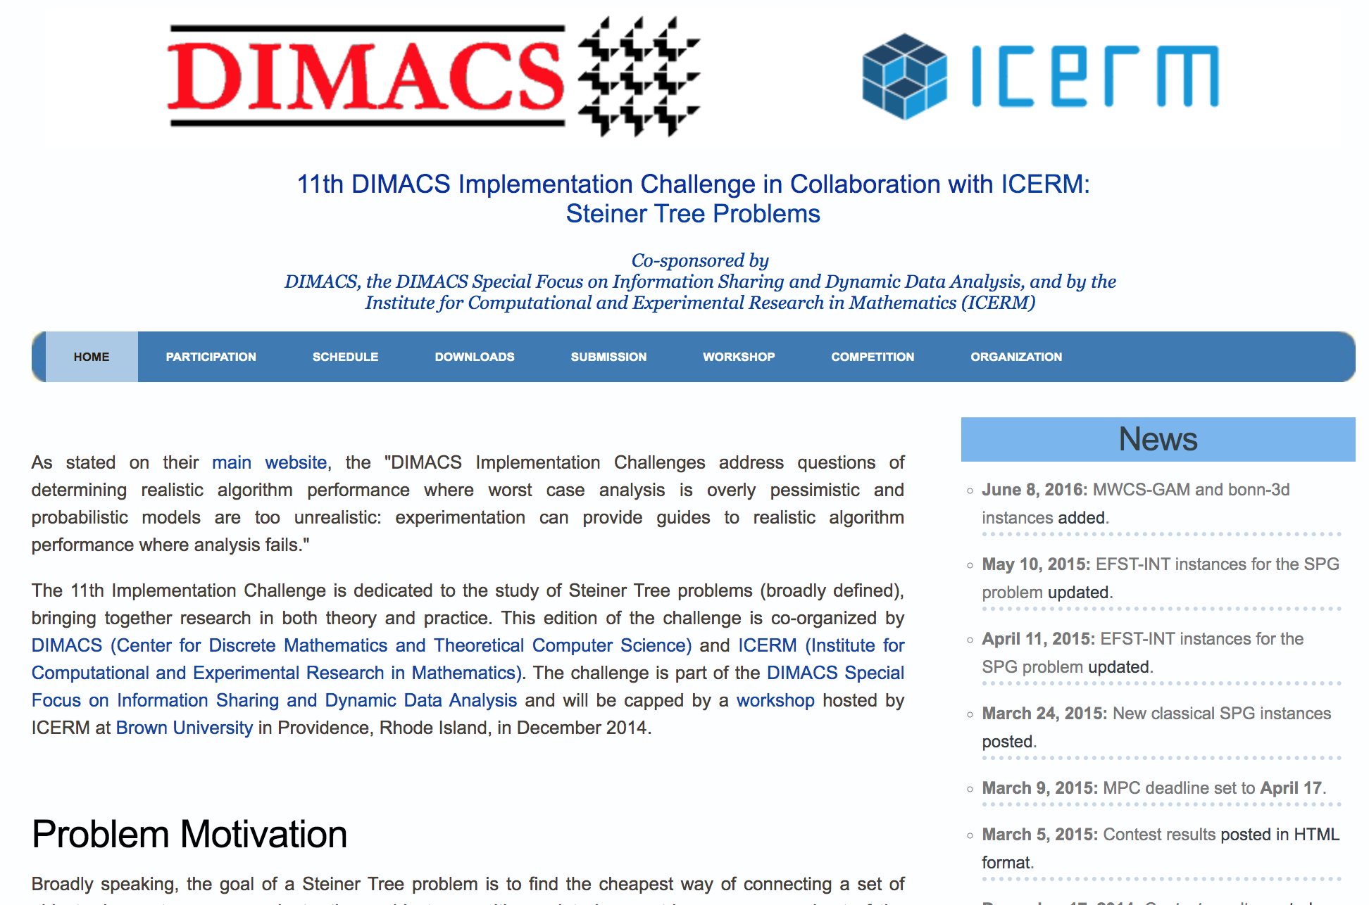
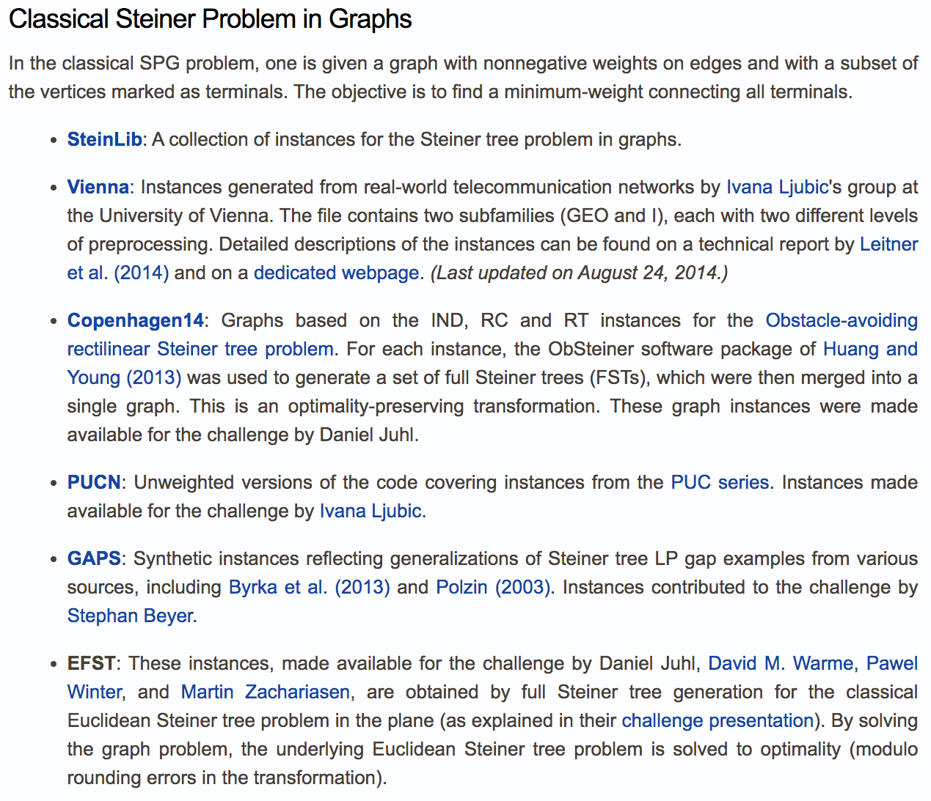
11th DIMACS Implementation Challenge
11th DIMACS Implementation Challenge in Collaboration with ICERM: Steiner Tree Problems: https://dimacs11.zib.de/home.html

Slide 28
How to Handle Non-unit Grids?
Practical maze routing (routing area) are non-unit
Wires should avoid going through high-congested areas
Wires should avoid going through blocked areas
Wires should avoid going through constrained areas
…
Can we apply maze routing algorithm still?

Slide 29
Maze Router on Non-unit Grids
Old problem
Each cell in grid costs the same to cross it with a wire
Cost ==1, unit-cost
Is this necessary? No!
Now, in practice
Given grid, Source and target
Different weights for each cell
Problem formulation
Find minimum cost path (i.e., shortest path) connecting source and target.
S
3 3 3 3
3 3 3 3
T

Slide 30
Maze Router on Non-unit Grids (cont’d)
Old problem
Each cell in grid costs the same to cross it with a wire
Cost ==1, unit-cost
Is this necessary? No!
Now, in practice
Given grid, Source and target
Different weights for each cell
Problem formulation
Find minimum cost path (i.e., shortest path) connecting source and target.
S
3 3 3 3
3 3 3 3
T

Slide 31
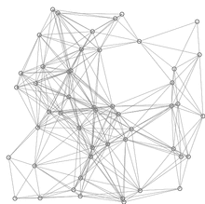
Recap: Graph Algorithm Lecture
Shortest-path-faster algorithm (SPFA)
Only perform relaxation from active vertices
Largely reduce the relaxation times
procedure SPFA(G, s)
1 for each vertex v ≠ s in V(G)
d(v) := ∞
d(s) := 0
push s into Q
while Q is not empty do
u := Q.pop()
for each edge (u, v) in E(G) do
if d(u) + w(u, v) < d(v) then
d(v) := d(u) + w(u, v)
if v is not in Q then
push v into Q
Relaxation happens only at active vertices (in queue) – largely reduced redundant relaxations!
red lines are shortest path covering blue lines are relaxations

Slide 32
From SPFA to Dijkstra Algorithm
d[s] ← 0
for each v Î V – {s}
do d[v] ← ¥
S ← ∅
Q ← V ⊳ Q Replacing the SPFA queue with min priority queue!
while Q ¹ ∅
do u ← EXTRACT-MIN(Q)
S ← S È {u}
for each v Î Adj[u]
do if d[v] > d[u] + w(u, v)
then d[v] ← d[u] + w(u, v)
p[v] ← u
Relaxation happens only at the active vertex with the minimum (shortest) value discovered so far! (i.e., vertex u)

Slide 33
Summary
We have discussed the routing problem
We have discussed 2-pin net maze routing algorithm
We have discussed n-pin net maze routing algorithm
We have discussed problems of maze routing algorithm
We have discussed optimal “Steiner Tree” router
We have discussed weighted maze routing algorithm

